Slide 1

DNS TUNNLING DETECTION
SYSTEM
Presented by
Dinesh kumar T (cyber security)

Slide 2
CONTENTS
Abstract
Problem Statement
Proposed Solution
Objectives
Technologies Used
Detection Logic
Wireshark Analysis
Splunk Monitoring
Live Demo
Results & Analysis
Conclusion

Slide 3
ABSTRACT
Dns tunneling detection system is a cybersecurity project used to find suspicious dns traffic.
In this project, wireshark is used to capture dns packets, and python is used to analyse them.
Suspicious dns queries are detected based on their length, pattern, and frequency.
The detected activities are sent to splunk for monitoring and alerts.
This helps to identify possible dns tunneling attacks and improve network security.

Slide 4
PROBLEM STATEMENT
DNS is normally used for domain name resolution.
Attackers can misuse DNS to hide data or communicate secretly.
Suspicious DNS traffic can be difficult to identify manually.
Long, random, and frequent DNS queries may indicate possible DNS tunneling.
Therefore, a system is needed to detect and monitor suspicious DNS behaviour.

Slide 5
PROPOSED SOLUTION
Capture DNS traffic using Wireshark.
Analyse DNS queries using Python.
Detect long, random, or frequent DNS queries.
Calculate a risk score for suspicious activity.
Send detected logs to Splunk.
Use Splunk for monitoring, dashboard, and alerts.
Help identify possible DNS tunneling activity in the network.

Slide 6
OBJECTIVES
To capture DNS traffic using Wireshark.
To analyse DNS queries using Python.
To identify suspicious DNS patterns.
To calculate a risk score for DNS queries.
To monitor detected activities using Splunk.
To generate alerts for suspicious DNS activity.
To help detect possible DNS tunneling.

Slide 7
TECHNOLOGIES USED
🐍 Python – DNS traffic analysis and detection
🔬 Scapy – Capturing and processing DNS packets
🦈 Wireshark – DNS packet capture and analysis
📊 Splunk – Log monitoring, dashboard and alerts
💻 PowerShell – Desktop alert notification
🪟 Windows – Project environment

Slide 8
DETECTION LOGIC
Risk Score = Length Score + Entropy Score + Digit Ratio Score + Frequency Score
Risk Score Calculation:
Query Length ≥ 15 → +25
Query Length ≥ 25 → +10
Entropy ≥ 3.2 → +25
Digit Ratio ≥ 0.25 → +15
Query Frequency ≥ 10 → +25
Query Frequency ≥ 5 → +10
Risk Score ≥ 50 → POSSIBLE SUSPICIOUS DNS
Risk Score < 50 → NORMAL / LOW RISK

Slide 9
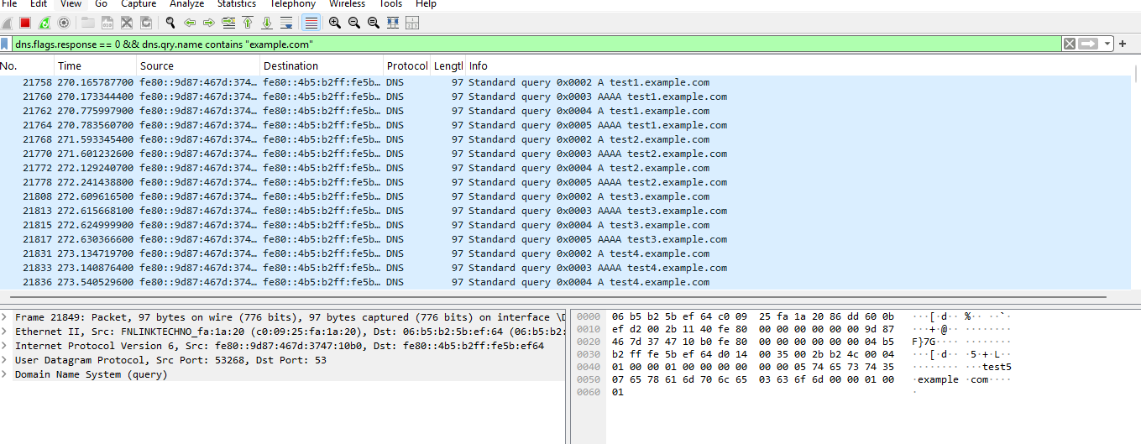
WIRESHARK ANALYSIS

Slide 10
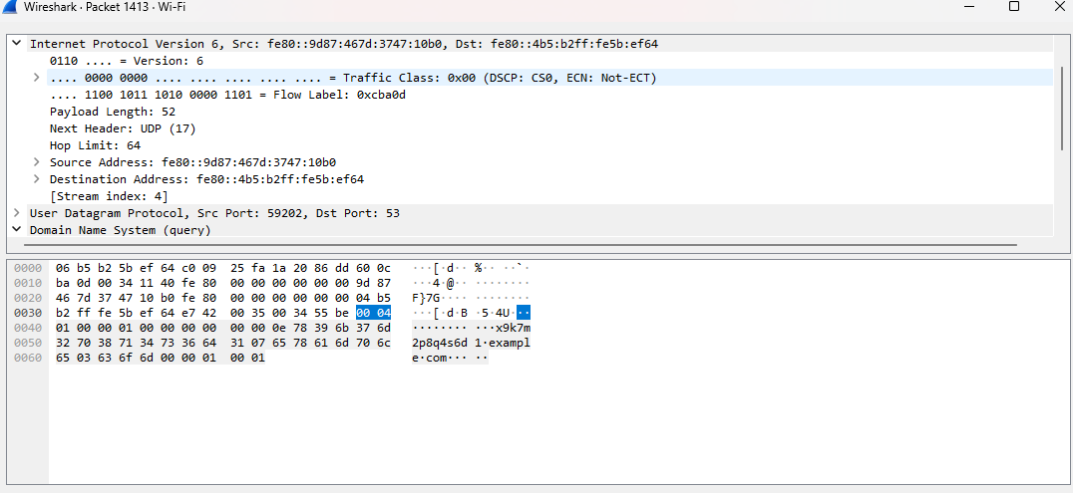
WIRESHARK ANALYSIS

Slide 11
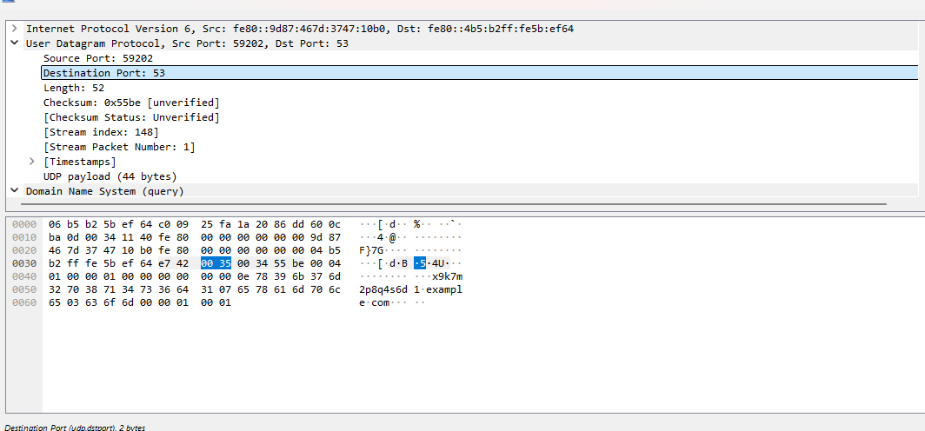
WIRESHARK ANALYSIS

Slide 12
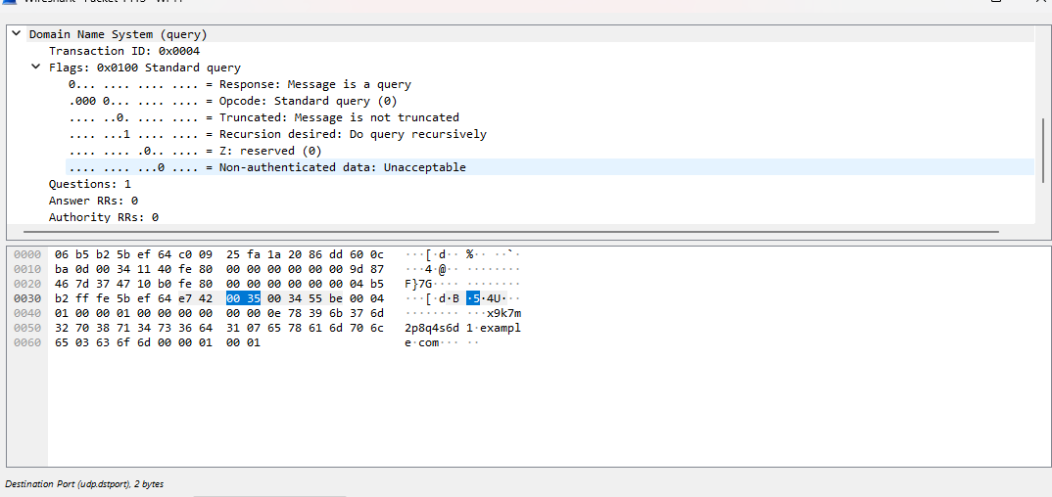
WIRESHARK ANALYSIS

Slide 13
WIRESHARK ANALYSIS
DNS packets captured using Wireshark
DNS query names analysed
Long/random queries identified
Query frequency and packet details observed

Slide 14
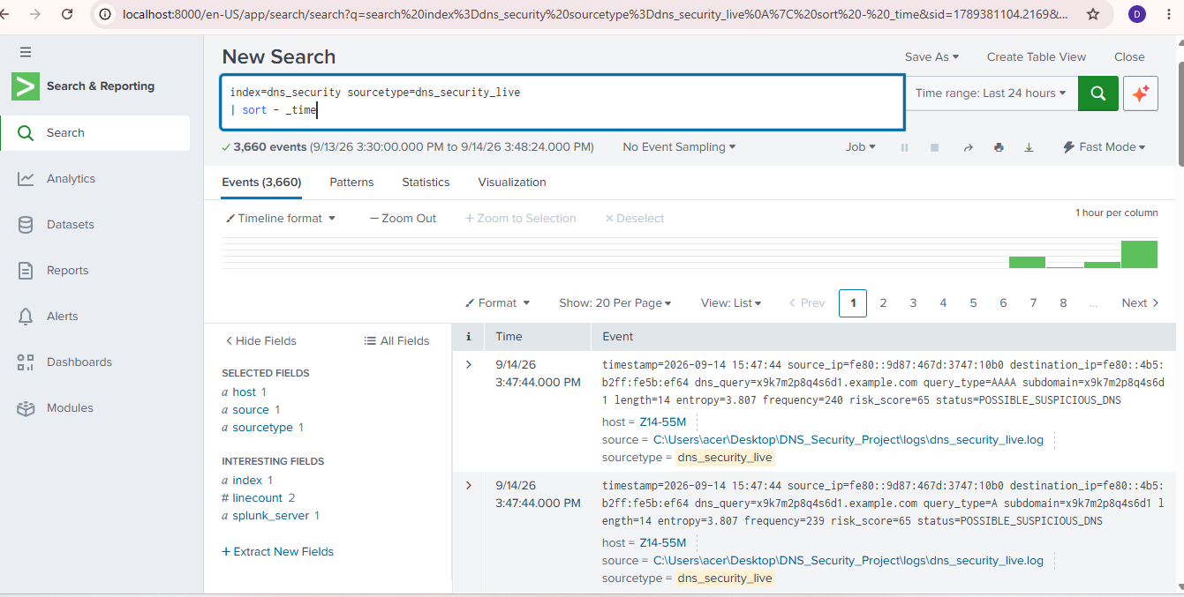
SPLUNK MONITORING

Slide 15
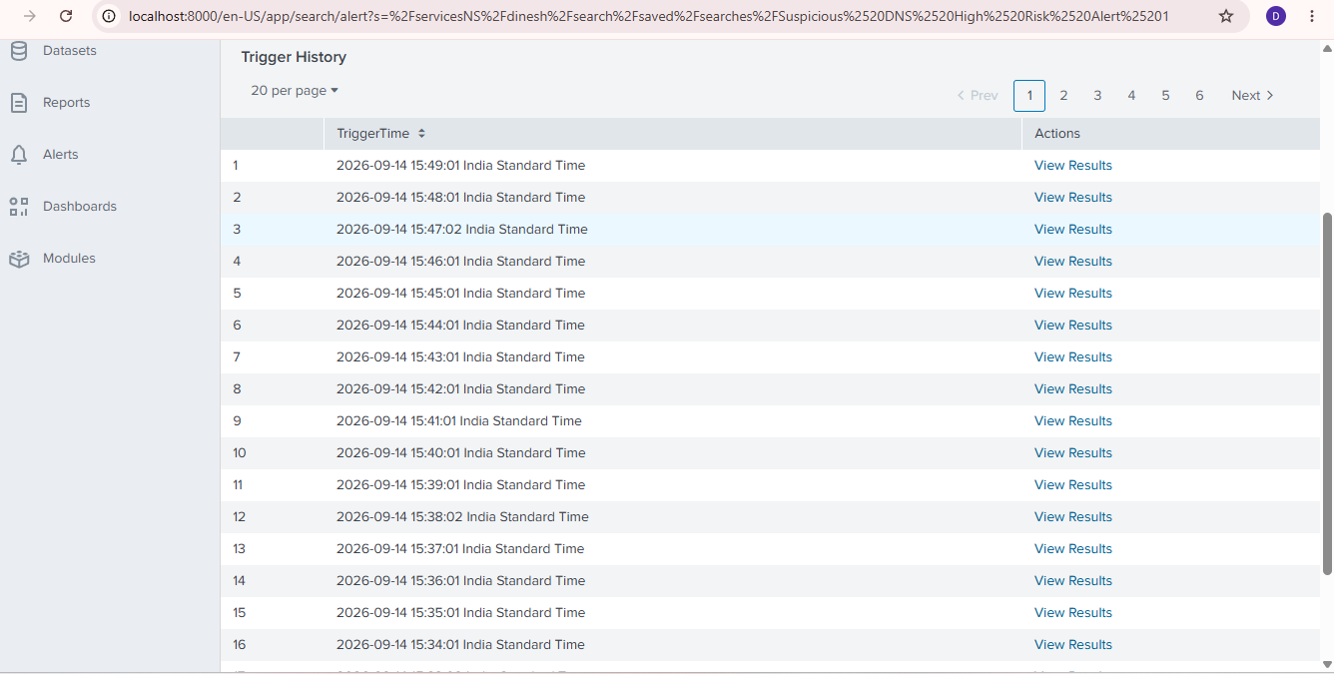
SPLUNK MONITORING

Slide 16
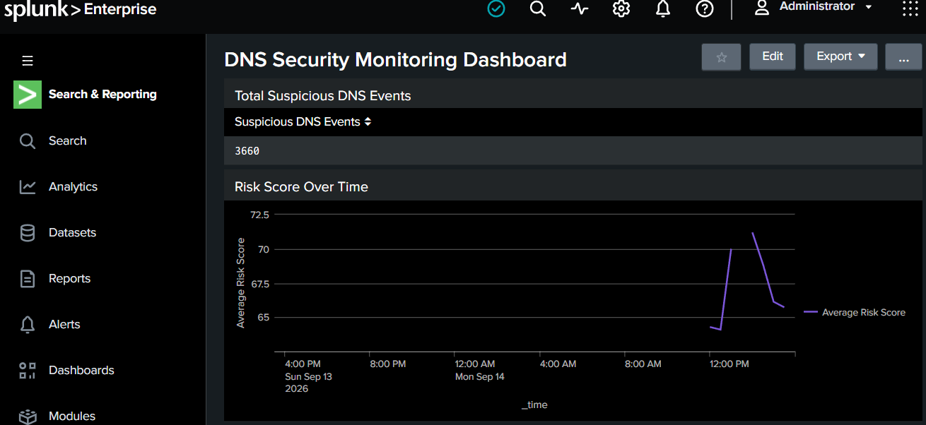
SPLUNK MONITORING

Slide 17
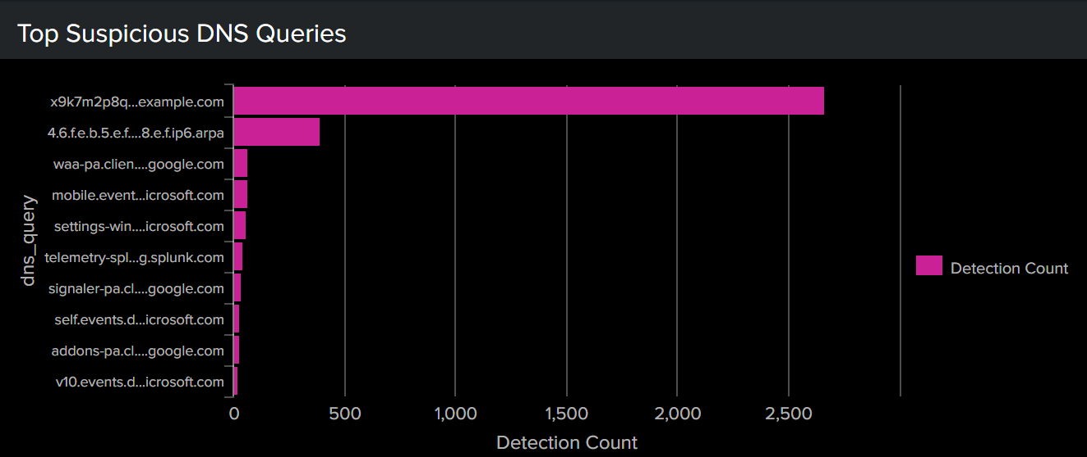
SPLUNK MONITORING

Slide 18
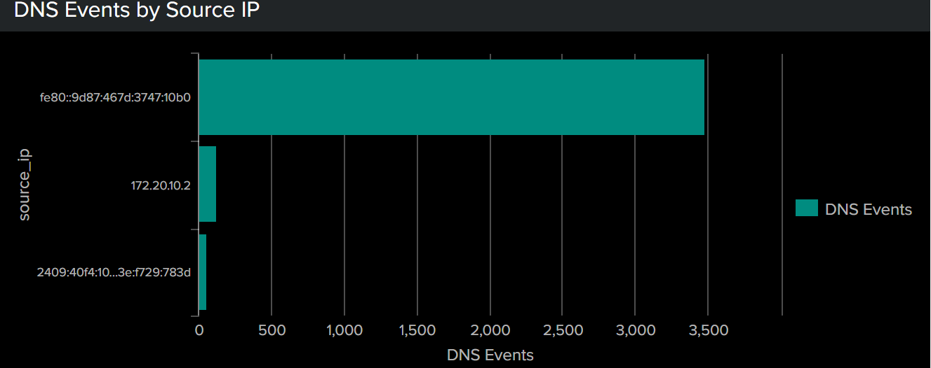
SPLUNK MONITORING

Slide 19
LIVE DEMO
Start Python DNS Monitor
Capture DNS Traffic using Wireshark
Generate 30 Synthetic DNS Queries
Python detects Suspicious DNS Activity
Windows Notification is displayed
Suspicious logs are sent to Splunk
Splunk Alert & Dashboard shows the activity
🔄 Demo Flow
CMD → DNS Traffic → Wireshark → Python Detection → Windows Notification → Splunk Alert

Slide 20
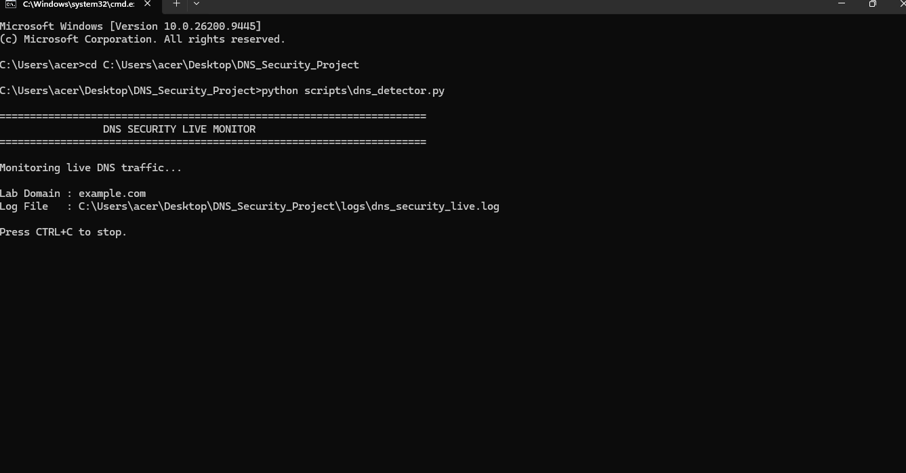
LIVE DEMO

Slide 21
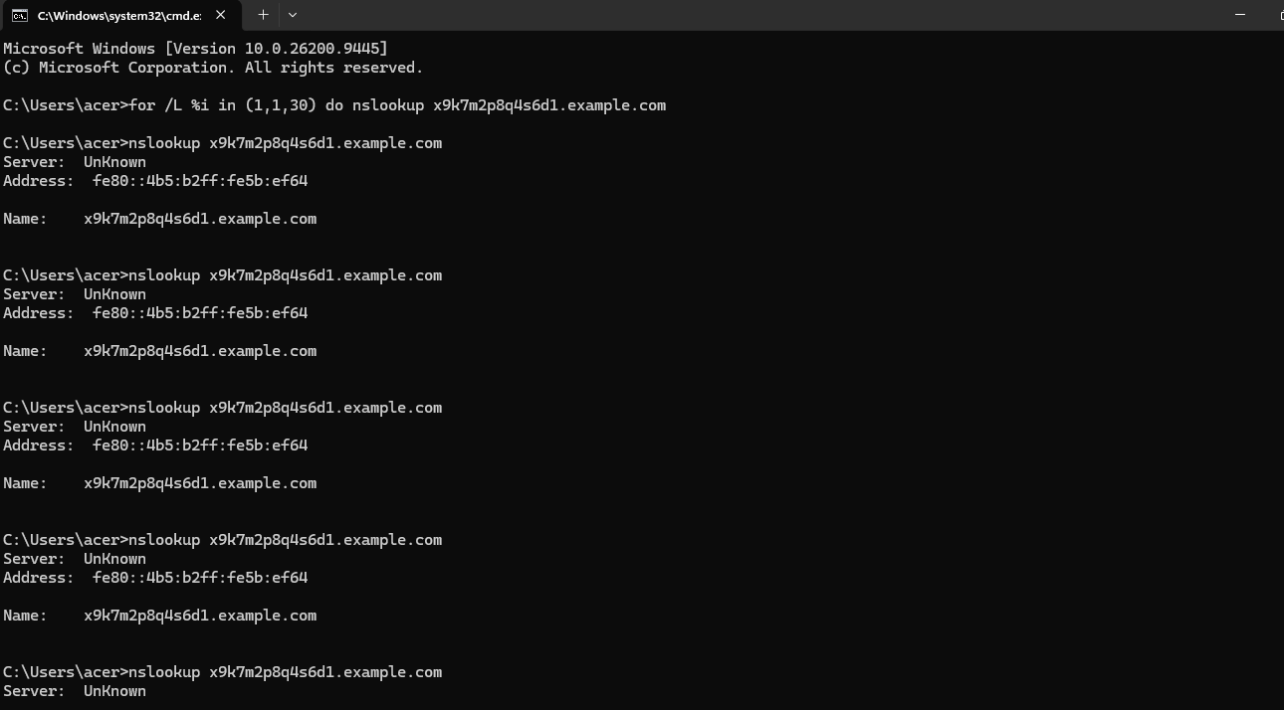
LIVE DEMO

Slide 22
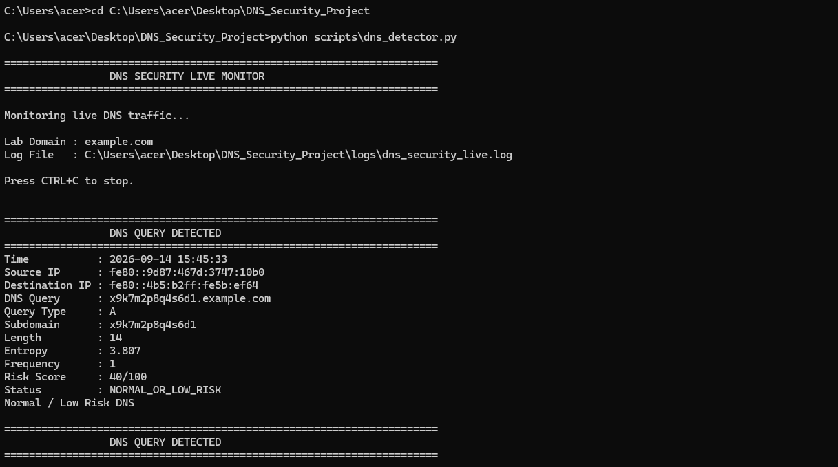
LIVE DEMO​

Slide 23
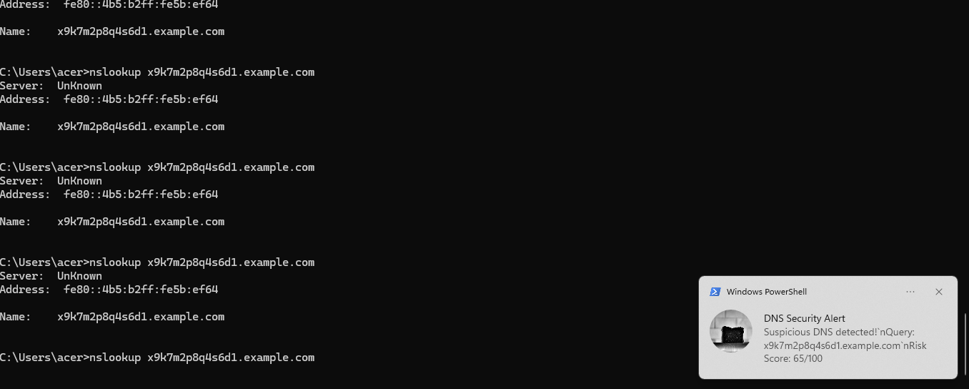
LIVE DEMO​

Slide 24
RESULT & ANALYSIS
Dns traffic was successfully captured using wireshark.
Python successfully analysed dns queries.
Long, random and frequent queries were identified as suspicious.
A risk score was calculated for each dns query.
Suspicious activity generated a windows notification.
Detected events were successfully sent to splunk.
Splunk displayed the events and triggered security alerts.
The system successfully identified possible dns tunneling behaviour in the test traffic

Slide 25
CONCLUSION
The DNS Tunneling Detection System successfully detects suspicious DNS behaviour.
Wireshark helps capture and analyse DNS traffic.
Python identifies suspicious queries using different detection factors.
Splunk provides log monitoring, dashboards and alerts.
Windows Notification gives an immediate alert to the user.
The system helps in identifying possible DNS tunneling activity and improves network security.
“This project provides a simple and effective way to monitor DNS traffic and detect possible suspicious activity.”

